Slide 1

Tutorial Session 1a: Using Past Models to Bridge to Open Models and Open Science Using nlmixr2
Chairs: Matthew L. Fidler and William S. Denney
Matthew Fidler | Basics of nlmixr2/rxode2 Model Syntax
William Denney | How to import NONMEM and Monolix Models into the nlmixr2/rxode2 Model Function using nonmem2rx and monolix2rx
Mirjam Trame | Simulate New Dosing Scenarios using RxODE2
Theodoros Papathanasiou | Re-estimate New Data Using nlmixr2
Justin Wilkins | Individualize Dosing Using posologyr
Phoenix, AZ November 10 – 13, 2024

Slide 2

Please ensure that you have all packages installed and course materials downloaded
https://github.com/nlmixr2/courses/tree/main/ACoP2024

Slide 3

Basics of nlmixr2/rxode2 Model Syntax
Matthew L. Fidler, M.Stat., Ph.D.
Director, Pharmacometrics
Novartis
Phoenix, AZ November 10 - 13, 2024

Slide 4
nlmixr²: an open-source package for pharmacometric modeling in R
ACoP Conference 2024 tutorial
Matthew Fidler
On behalf of the nlmixr2 development team:
Matt Fidler, Bill Denney, Richard Hooijmaijers, Rik Schoemaker, Mirjam Trame, Theodoros Papathanasiou, Justin Wilkins, John Harrold

Slide 5
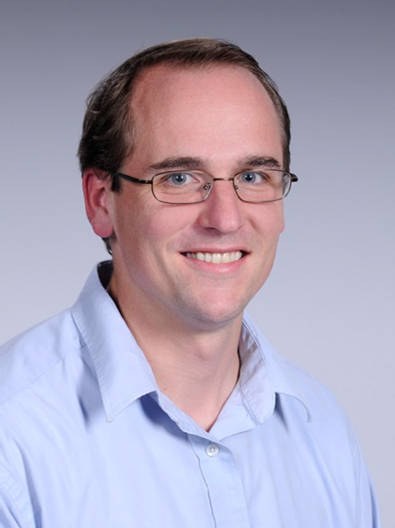

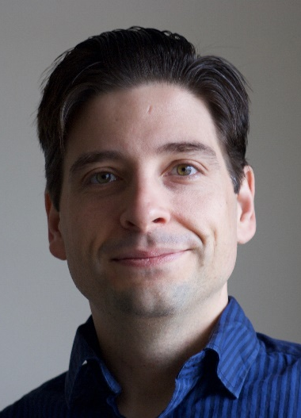

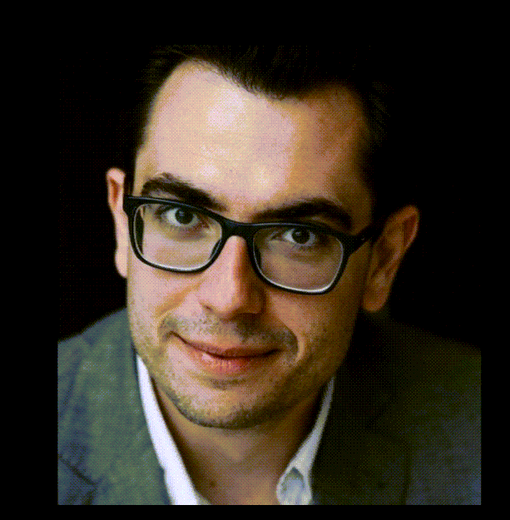
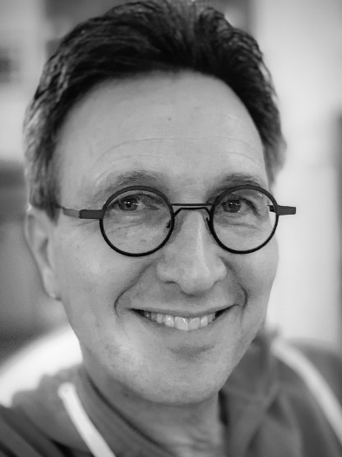
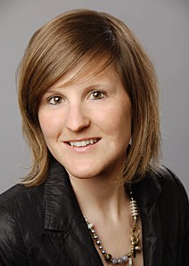
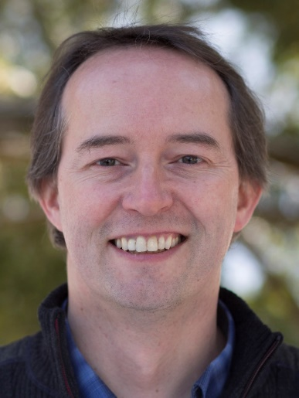

Active nlmixr2 team
Matthew Fidler, PhD
Bill Denney, PhD
John Harrold, PhD
Richard Hooijmaijers, BSc
Theo Papathanasiou, PhD
Rik Schoemaker, PhD
Mirjam Trame, PhD
Justin Wilkins, PhD
Max Taubert, PhD

Slide 6


Vision of
²
To develop an R-based open-source nonlinear mixed-effects modeling software package that can compete with commercial pharmacometric tools and is suitable for regulatory submissions

Slide 7
nlmixr² is a nonlinear mixed effects modeling R package with comparable performance to commercial software
Run time for ODE model:
FOCEi: nlmixr runs faster than NONMEM
SAEM: nlmixr runs as fast as Monolix and both are faster than NONMEM
Parameter Estimates were similar for all three NLME tools.
Multiple known submission/approval to regulators (FDA, EMA etc)
Run Time (s)
Vc (L)
IIV Vc (%)
SE Vc (L)

Slide 8
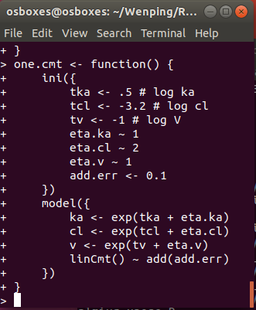
modeling syntax, running nlmixr² models and nlmixr² output

Slide 9
A nlmixr model has two main parts: initialization and model
Initialization ini({ }) | Model model({ })
Relationship of Fixed/Random Pars First
ini({
lCl <- 1.6; label("log Cl (L/hr)")
lVc = log(90); label("log V (L)")
lKa = fix(1) #log Ka (1/hr)
add.sd = 0.2
eta.Ka ~ 0.1 #IIV Ka
eta.Cl ~ c(0.1)
eta.Vc ~ c(0.005, 0.1)
})
model({
Cl = exp(lCl + eta.Cl)
Vc = exp(lVc + eta.Vc)
KA = exp(lKa + eta.Ka)
})
Parameters defined based on ini block
Fixed/Random relationships defined first
Model (Solved/RxODE) defined next
Unexplained error defined by formula (~)
label() or # (interactive only)
linCmt() ~ add(add.sd)
Lower triangular block matrix
Population and Residual Estimates are defined using assign operators (=)
Random Effects (ETAs) defined using a model formula (~; aka modelled by)

Slide 10
nlmixr uses defined parameters to select 1, 2 or 3 solved compartment model with linCmt() → closed-form solutions
Solved System Parameterization Support | Model model({ })
1 Compartment | 2 Compartment | 3 Compartment
Cl, V | Cl, V, Q, Vp | Cl, Vc, Q1, Vp1, Q2 Vp2
Kel, V | Kel, k12, k21, V | Kel, k12, k21, k13, k31, V
A, alpha | A, alpha, B, beta | A, alpha, B, beta, C, gamma
model({
Cl = exp(lCl + eta.Cl)
Vc = exp(lVc + eta.Vc)
KA = exp(lKa + eta.Ka)
})
Vp = exp(lVp)
Cld = exp(lCld)
linCmt() ~ prop(prop.sd)
nlmixr also uses parameter aliases; Examples:
V =Vc = V1 and Q = Cld.
Parameter case does not matter
Parameter aliases are context dependent.
The first can be Volume = Vc, (Can start with V2)
Second numbered Volume = Vp
All NONMEM style parameters are supported.
CMT #1 = depot (w/Ka) / central (without Ka) compartment
1 compartment solved model is specified by linCmt()
2 and 3 compartment model is also specified by linCmt()
Type of model depends on provided parameters
https://nlmixr2.github.io/rxode2/articles/rxode2-model-types.html#solved-compartment-models

Slide 11
A nlmixr model block in case of no closed-form solution or PD model and ODE model block is required → linCmt cannot be used
Initialisation ini({ }) | Model model({ })
model({
Cl = exp(lCl + eta.Cl)
Vc = exp(lVc + eta.Vc)
KA = exp(lKa + eta.Ka)
})
Parameters defined based on ini block
Fixed/Random relationships defined first
Model (Solved/RxODE) defined next
Unexplained error defined by formula (~)
ini({
lCl = 1.6; label("log Cl (L/hr)")
lVc = log(90); label("log V (L)")
lKa = 1 #log Ka (1/hr)
prop.sd = 0.2
eta.Ka ~ 0.1 #IIV Ka
eta.Cl + eta.Vc ~ c(0.1,
0.005, 0.1)
})
Relationship of Fixed/Random Pars First
label() or # (interactive only)
kel = Cl / Vc
d/dt(depot) = -KA*depot
d/dt(centr) = KA*depot-kel*centr
cp = centr / Vc
Lower triangular block matrix
instead of linCMT
cp ~ prop(prop.sd)
Population and Residual Estimates are defined using assign operators (=)
Random Effects (ETAs) defined using a model formula (~; aka modelled by)

Slide 12
Add Bioavailability (F) and lag time (alag) to the model
Initialisation ini({ }) | Model model({ })
Relationship of Fixed/Random Pars First
ini({
lCl = 1.6; label("log Cl (L/hr)") lVc = log(90); label("log V (L)")
lKa = 1 #log Ka (1/hr)
lf = log(1)
lalag = log(0.5)
prop.sd = 0.2
eta.Ka ~ 0.1 #IIV Ka
eta.Cl + eta.Vc ~ c(0.1,
0.005, 0.1)
})
model({
Cl = exp(lCl + eta.Cl)
Vc = exp(lVc + eta.Vc)
KA = exp(lKa + eta.Ka)
fD = exp(lf)
lagD = exp(lalag)
})
label() or # (interactive only)
kel = Cl / Vc
d/dt(depot) = -KA*depot
alag(depot) = lagD
f(depot) = fD
d/dt(centr) = KA*depot-kel*centr
cp = centr / Vc
cp ~ prop(prop.sd)
Lower triangular block matrix
Population and Residual Estimates are defined using assign operators (=)
Can also add rate/dur for modeled duration and rate
Random Effects (ETAs) defined using a model formula (~; aka modeled by)

Slide 13
Residual Error models and Multiple Endpoints
Error Model | Coding | Supported By
Additive/Normal | Y ~ add(add.sd) | nlme, fo, foi, foce, focei, saem
Proportional | Y ~ prop(prop.sd) | nlme, fo, foi, foce, focei, saem
Additive + Proportional | Y ~ add(add.sd) + prop(prop.sd) | nlme, fo, foi, foce, focei, saem
Lognormal/Exponential Note: normal scale OBJF | Y ~ lnorm(lnorm.sd) | fo, foi, foce, focei, saem
Power Model | Y ~ pow(pow.sd, pow) | fo, foi, foce, focei, saem
Additive + Power | Y ~ add(add.sd) + pow(pow.sd, d) | fo, foi, foce, focei, saem
Box-Cox transform both sides | Y ~ add(add.sd) +boxCox(lambda) | fo, foi, foce, focei, saem
Yeo-Johnson transform both sides | Y ~ add(add.sd) + yeoJohnson(lambda) | fo, foi, foce, focei, saem
Multiple Endpoint:
PK ~ add(add.sd) + prop(prop.sd) | depot
PD ~ add(pd.sd) | err
Now generalized llik for focei

Slide 14
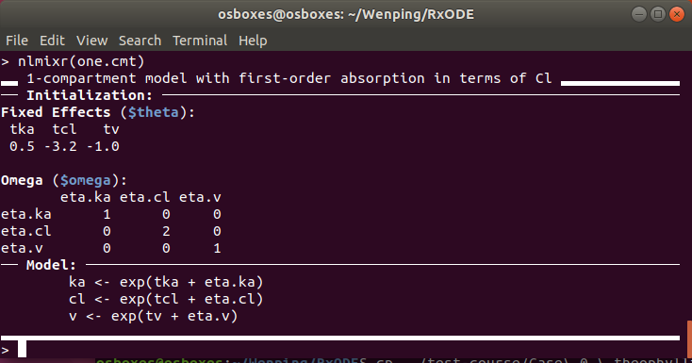
Finalizing and checking a nlmixr model verifies nlmixr detects the correct solved model (or RxODE model), as well as showing the parsed initial estimates
Finalising models | Checking how the model is parsed
To finalize a model, put the ini and model in a named function
By calling nlmixr on the named R function, it will tell you how nlmixr parsed the model; This is especially useful in checking what solved system nlmixr detected before running the entire model

Slide 15
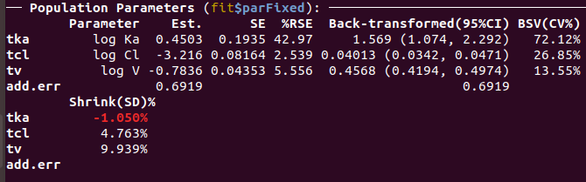
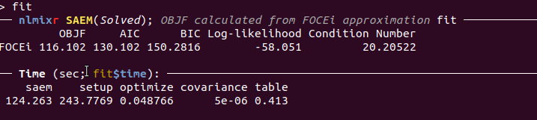
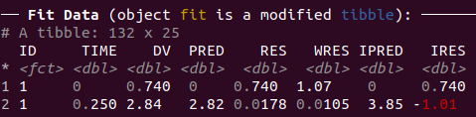
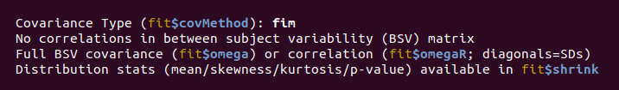
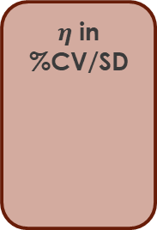
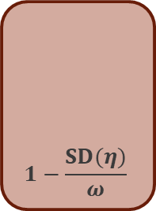
Fitting nlmixr models takes the estimation method (with its options) and produces a nlmixr combined dataset/fit object
Assigned R object
Estimation methods = (“nlme”, “saem”, “focei”, “foce”, “foi”, “fo”)
Optional if cwres and or npde calculations wanted
fit <- nlmixr(one.cmt, data, est = "saem", table=tableControl(cwres=TRUE, npde=TRUE))
Function Name is run name
# Labels
$η$ in %CV/SD
Model Based
Est.
Transformed to be on “natural” scale. CIs are on the same scale
$$1−\frac{SD(η)}{ω}$$

Slide 16
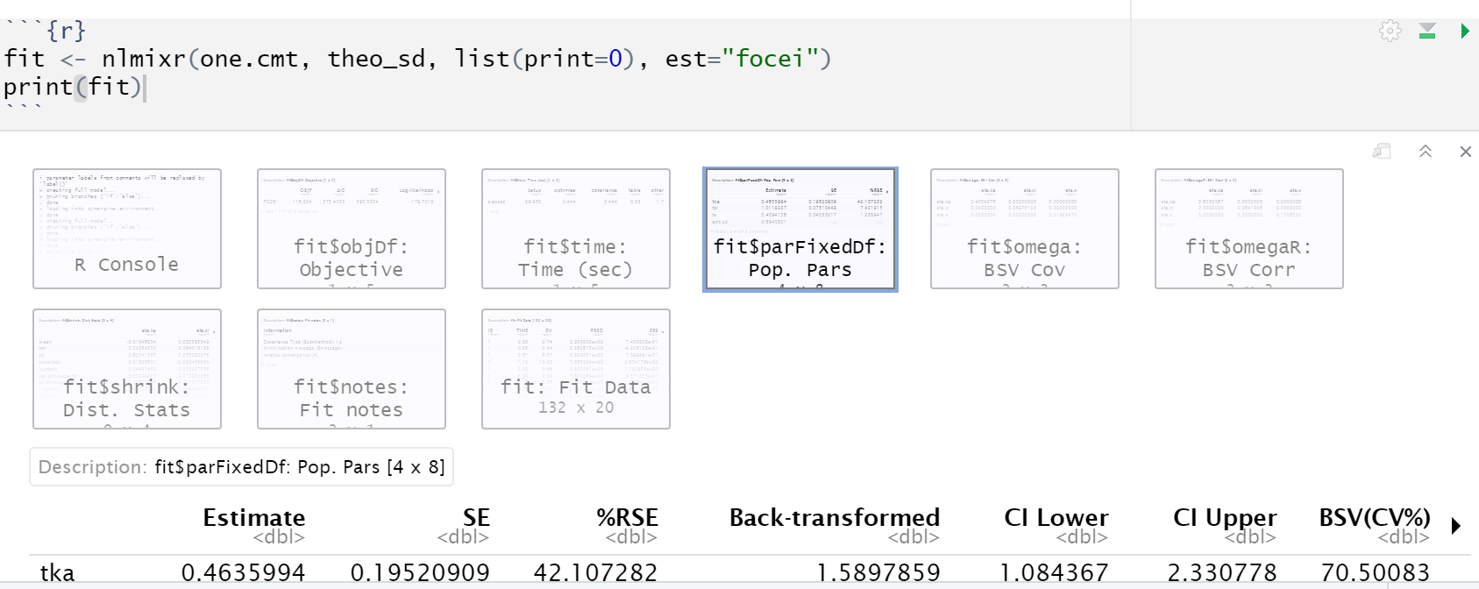
In Rstudio’s Rmarkdown or notebook, the output is similar but in tabular form that is easier to click through

Slide 17
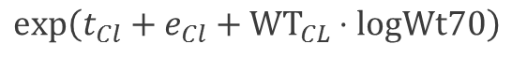
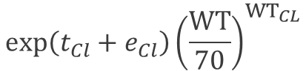
Inclusion of Covariates into a SAEM nlmixr model
Initialization ini({ })
ini({
lCl = 1.6 #log Cl (L/hr)
lVc = log(90) #log V (L)
lKa = fix(1) #log Ka (1/hr)
beta.wt = 0.75 #estimate of covariate effect
prop.sd = c(0,0.2,1)
eta.Ka ~ 0.1 #IIV Ka
eta.Cl + eta.Vc ~ c(0.1, 0.005, 0.1)
})
Random or Individual Parameter
$${exp⁡\left(t_{Cl}+e_{Cl}\right)\left(\frac{WT}{70}\right)}^{{WT}_{CL}}$$
Cl = exp( tCl + eta.Cl + beta.wt * lnWt70 )
Fixed or Population Parameter
Covariate Estimate times transformed covariate
$$exp⁡\left(t_{Cl}+e_{Cl}+{WT}_{CL}⋅logWt70\right)$$

Slide 18
Resources, documentation and further reading
Home of nlmixr2, rxode2, xpose.nlmixr2, support packages (most recent versions)
https://github.com/nlmixr2 New version of nlmixr
Documentation: continually evolving
https://nlmixr.org/
Open course material and recent discussion:
https://blog.nlmixr2.org
LinkedIn: https://www.linkedin.com/groups/8621368/

Slide 19
How to import NONMEM and Monolix Models into the nlmixr2/rxode2 Model using nonmem2rx and monolix2rx
William S. Denney, Ph.D.
Chief Scientist
Human Predictions
Phoenix, AZ November 10 - 13, 2024

Slide 20

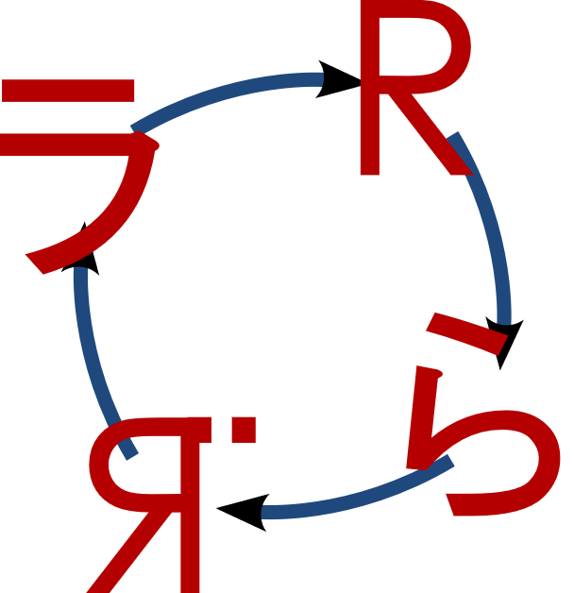
Hands-on for importing NONMEM models into nlmixr2/rxode2 (nonmem2rx)
Please load “nonmem2rx_example.R”
nonmem2rx and monolix2rx
Loads existing models from NONMEM or Monolix
Validates model loading
Rerun the model using the population and individual parameters.
Does rxode2/nlmixr2 get the same answer as the original model?
nonmem2rx and monolix2rx can
Enable easy simulation of that model
Enable easy reporting of that model
Enable easy reproduction of that model in different software

Slide 21
Simulate New Dosing Scenarios using RxODE²
Mirjam N. Trame, Pharm.D., Ph.D.
VP, Pharmacometrics
Certara Drug Development Solutions
Phoenix, AZ November 10 - 13, 2024

Slide 22

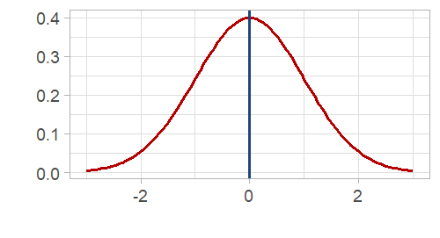
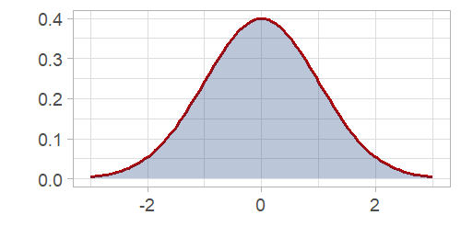
simulating from a nlmixr² model
multi-subject
Without uncertainty
With uncertainty

Slide 23
Excursion to RxODE²

Slide 24


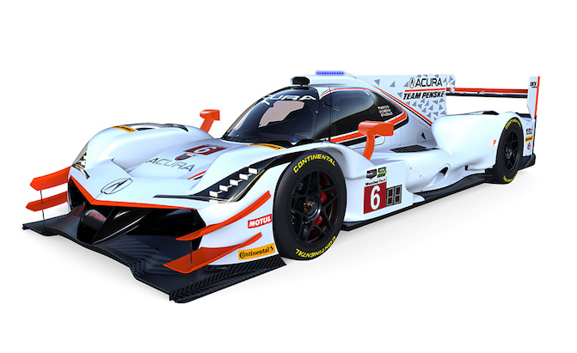
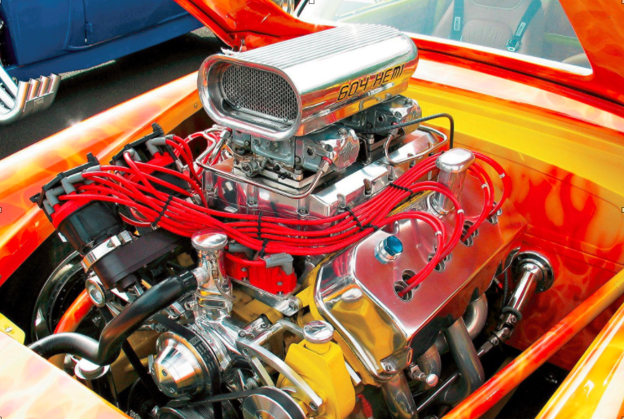
RxODE² is the ODE solving engine that powers the estimation methods of nlmixr²
Solve ODEs
Estimate Parameters
What do I need to know about RxODE²?
What in RxODE² is used by nlmixr²?
What in RxODE² is output by nlmixr²?

Slide 25
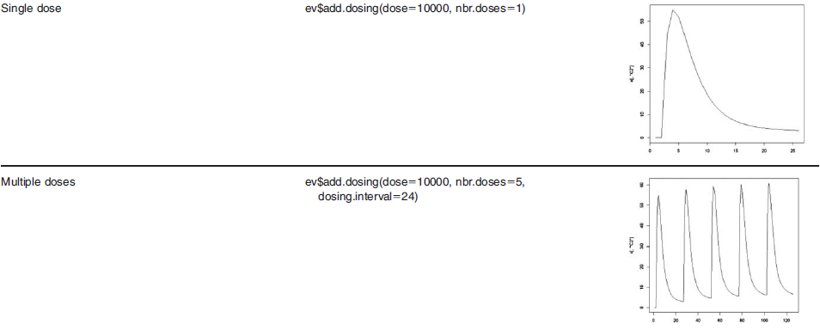
Specify a variety of dosing schedules using the add.dosing() function
Can also use NONMEM-style events by et
et(amt=10000)
Can also use NONMEM-style events by et
et(amt=10000, addl=4, ii=24)
Wang W. et al. A Tutorial on RxODE: Simulating Differential Equation Pharmacometric Models in R. CPT:PSP (2016)5,3-10

Slide 26
Creating an eventTable with et(), add.sampling(), add.dosing()
add.sampling = function( | Sampling Times ) | et = function( | Sampling times)
add.dosing = function( |  | et = function(
dose, | # dose amount | amt, | # dose amount
nbr.doses, | # number of doses | addl, | # additional doses nbr.doses – 1
dosing.interval=24, | # dosing interval | ii, | # dosing interval
dosing.to=1, | # where to dose | cmt, | # where to dose
rate=NULL, | # infusion rate | rate | # infusion rate
start.time=0 | # dosing start time | time | # dosing start time
) |  | )
add.dosing(), add.sampling() or et() can be called incrementally multiple times
ev <- eventTable(amount.units="mg", time.units="hours") %>%
add.dosing(dose=10000, nbr.doses=10, dosing.interval=12) %>%
add.dosing(dose=20000, nbr.doses=5,
start.time=120,dosing.interval=24) %>%
add.sampling(0:240);

Slide 27
Back to Simulating with nlmixr²

Slide 28
Simulating using nlmixr² Simulate a new regimen (BID) – No Parameter Uncertainty
Load nlmixr2 | library(nlmixr2)
Specify ODE models | model({ C2 = centr/V2; d/dt(depot) =-KA*depot; d/dt(centr) = KA*depot - CL*C2; })
Specify Dosing & Sampling | ev <- eventTable()# For nlmixr & RxODE simulations ev$add.dosing(dose=4.7,nbr.doses=2,dosing.interval=12) #assume BID ev$add.sampling(seq(0,24,length.out=51))
Simulate Events | n <- 300 bid <- simulate(fit, events=ev, nSub=n*n)
Solved RxODE2 Object
nlmixr2 Object
Simulation Output: sim.id, time, ipred, sim

Slide 29
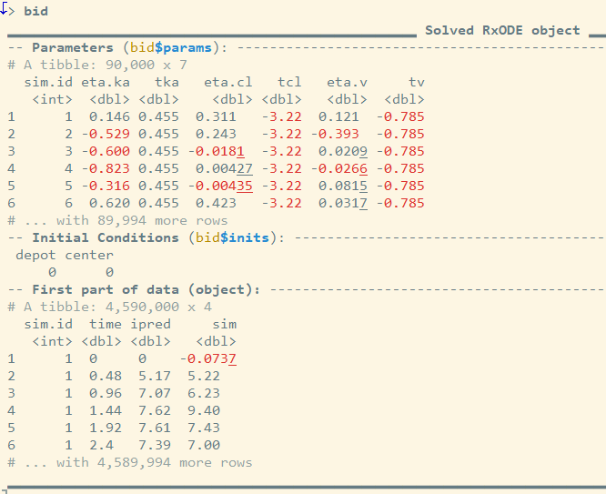
Simulation Output The simulation has information about the parameters that were used in the simulation from the model fit (= Solved RxODE2 object)
Constant Population Parameters
> summary(bid$params)
sim.id eta.ka tka eta.cl
Min. : 1 Min. :-2.9624044 Min. :0.4546 Min. :-1.2343951
1st Qu.:22501 1st Qu.:-0.4482224 1st Qu.:0.4546 1st Qu.:-0.1794427
Median :45001 Median :-0.0005998 Median :0.4546 Median : 0.0010281
Mean :45001 Mean :-0.0018905 Mean :0.4546 Mean : 0.0005723
3rd Qu.:67500 3rd Qu.: 0.4434868 3rd Qu.:0.4546 3rd Qu.: 0.1824282
Max. :90000 Max. : 2.7591093 Max. :0.4546 Max. : 1.1282721
tcl eta.v tv
Min. :-3.215 Min. :-0.5714017 Min. :-0.7848
1st Qu.:-3.215 1st Qu.:-0.0895164 1st Qu.:-0.7848
Median :-3.215 Median : 0.0009726 Median :-0.7848
Mean :-3.215 Mean : 0.0008345 Mean :-0.7848
3rd Qu.:-3.215 3rd Qu.: 0.0919098 3rd Qu.:-0.7848
Max. :-3.215 Max. : 0.5585632 Max. :-0.7848

Slide 30
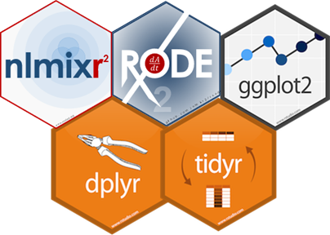
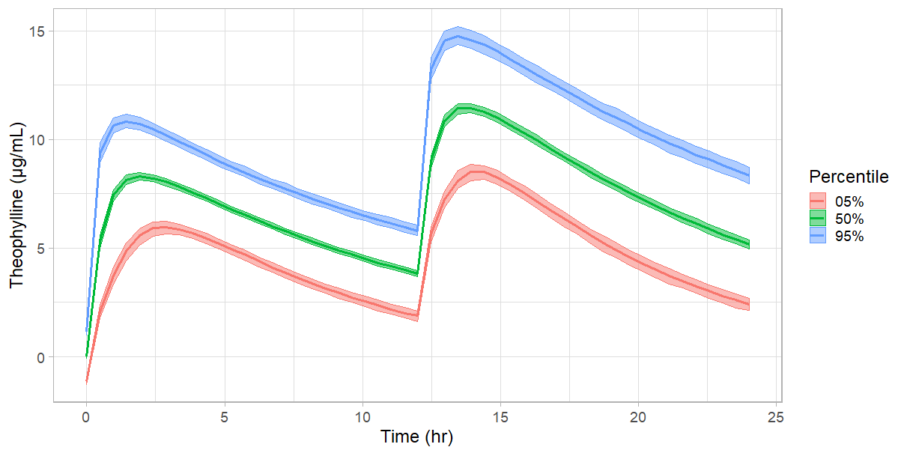
Simulate a new regimen (BID) – No Parameter Uncertainty
→ Simulation Plot
plot(bid) +
ylab("Theophylline (\u03BCg/mL)")+
xlab("Time (hr)")+
theme_light(base_size=18)

Slide 31
Simulating using nlmixr² Simulate a new regimen (BID) – With Parameter Uncertainty → add one additional parameter “nStud”
Load nlmixr2 | library(nlmixr2)
Specify ODE models | model({ C2 = centr/V2; d/dt(depot) =-KA*depot; d/dt(centr) = KA*depot - CL*C2; })
Specify Dosing & Sampling | ev <- eventTable()# For nlmixr & RxODE simulations ev$add.dosing(dose=4.7,nbr.doses=2,dosing.interval=12) #assume BID ev$add.sampling(seq(0,24,length.out=51))
Simulate Events | n <- 300 bid <- simulate(fit, events=ev, nSub=n, nStud=n)
nStud = # of “Studies” sampled
nSub = # subjects per study
Solved RxODE2 Object
nlmixr2 Object
Simulation Output: sim.id, time, ipred, sim
https://nlmixrdevelopment.github.io/RxODE/articles/RxODE-event-table.html

Slide 32
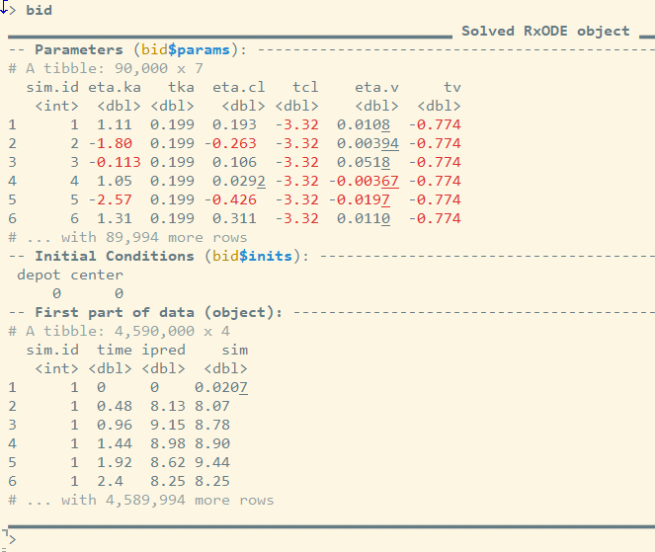
Simulation Output The simulation has information about the parameters that were used in the simulation from the model fit (= Solved RxODE2 object)
Changing Population Parameters
> summary(bid$params)
sim.id eta.ka tka eta.cl
Min. : 1 Min. :-5.910739 Min. :-0.09778 Min. :-1.3511807
1st Qu.:22501 1st Qu.:-0.363984 1st Qu.: 0.30723 1st Qu.:-0.0734019
Median :45001 Median : 0.001011 Median : 0.45434 Median :-0.0004093
Mean :45001 Mean : 0.001559 Mean : 0.43990 Mean :-0.0007771
3rd Qu.:67500 3rd Qu.: 0.364199 3rd Qu.: 0.56614 3rd Qu.: 0.0724550
Max. :90000 Max. : 6.003083 Max. : 0.94869 Max. : 1.7316982
tcl eta.v tv
Min. :-3.435 Min. :-1.0236210 Min. :-0.9172
1st Qu.:-3.263 1st Qu.:-0.0250715 1st Qu.:-0.8122
Median :-3.213 Median :-0.0000393 Median :-0.7860
Mean :-3.212 Mean : 0.0000356 Mean :-0.7848
3rd Qu.:-3.160 3rd Qu.: 0.0252582 3rd Qu.:-0.7530
Max. :-2.954 Max. : 0.8727193 Max. :-0.6597

Slide 33
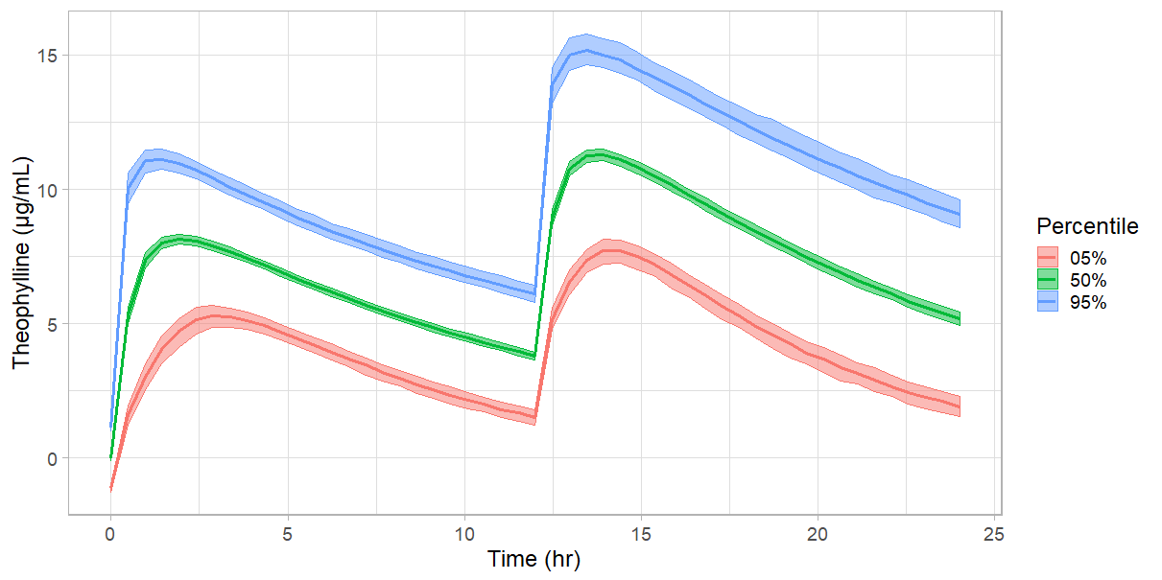
Simulate a new regimen (BID) – With Parameter Uncertainty → Simulation Plot
Higher Absorption Uncertainty
plot(bid) +
ylab("Theophylline (\u03BCg/mL)")+
xlab("Time (hr)")+
theme_light(base_size=18)

Slide 34
Optimal Design Using PopED and babelmixr2
Theodoros Papathanasiou, Ph.D.
Associate Director, Pharmacometrics
GSK
Phoenix, AZ November 10 - 13, 2024

Slide 35
Individualize Dosing Using posologyr
Justin Wilkins, Ph.D.
Owner and Senior Consultant
Occams
Phoenix, AZ November 10 - 13, 2024

Slide 36


Personalized drug regimens with posologyr and rxode2
Justin J. Wilkins, PhD Occams, Amstelveen, The Netherlands
Cyril Leven, PhD Brest University Hospital, Brest, France
and the nlmixr Development Team

Slide 37

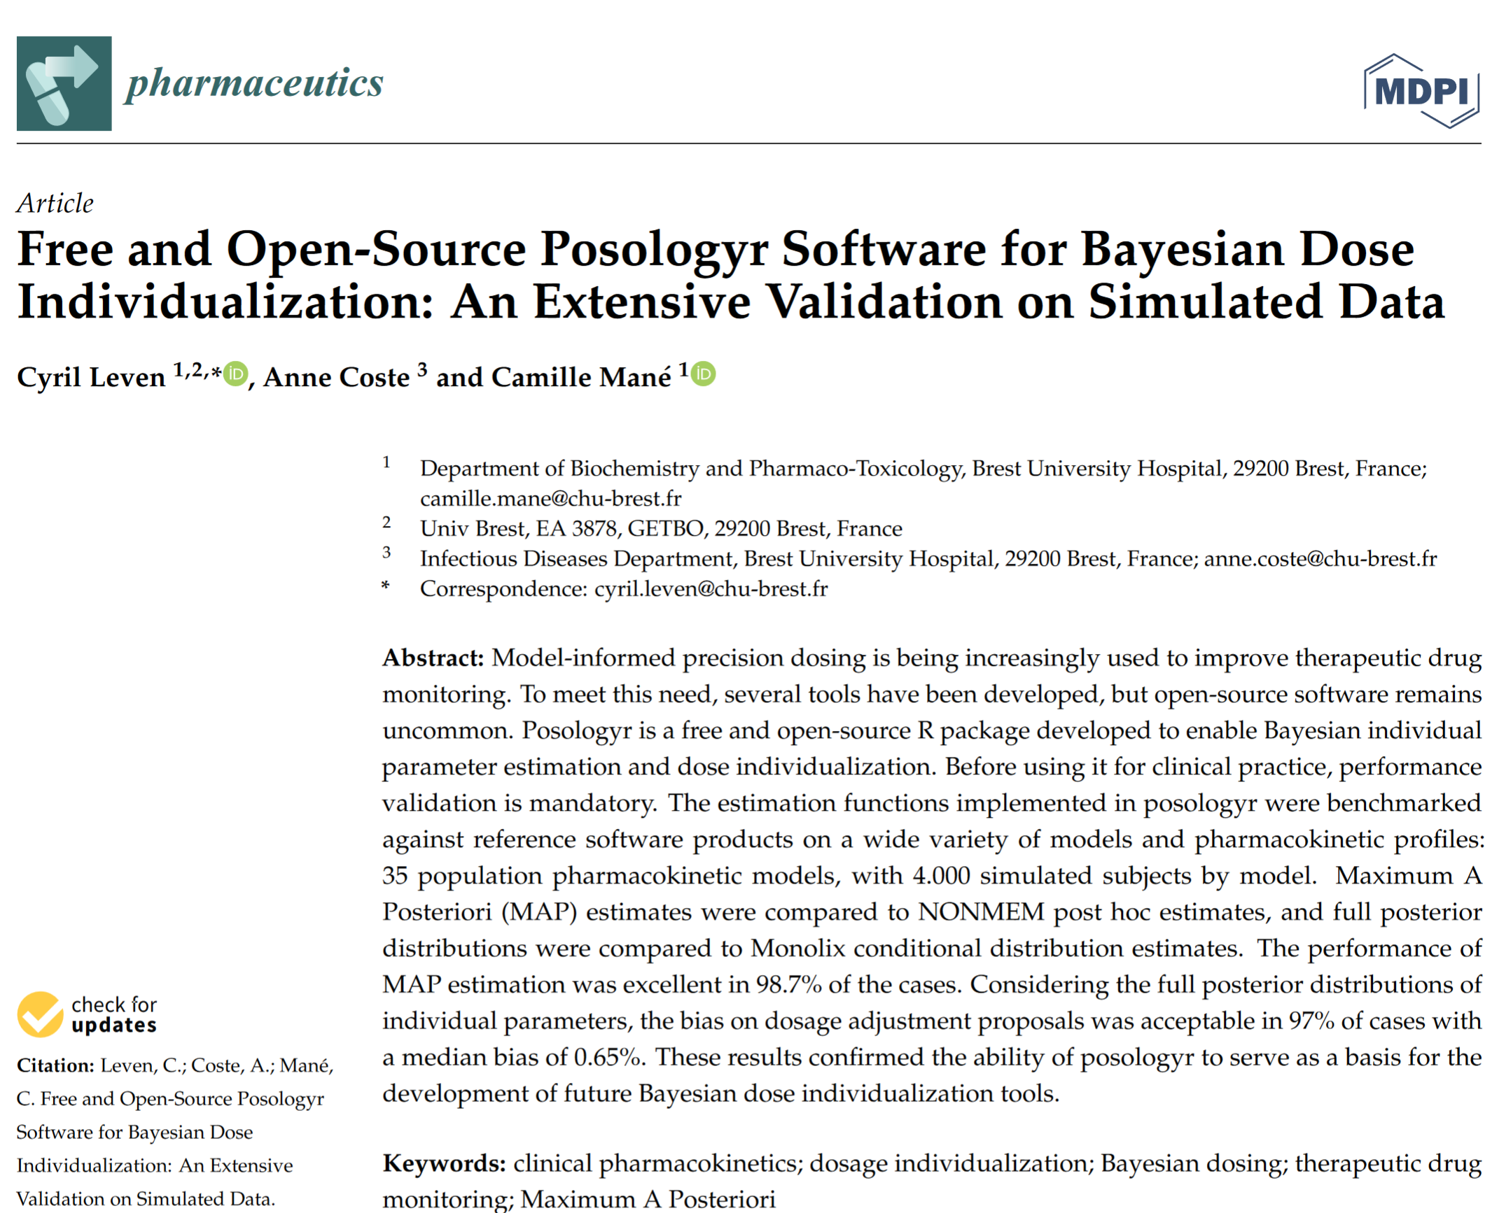
Introduction
posologyr is an R package developed (primarily) by Cyril Leven at Brest University Hospital to help with Bayesian dose individualization
By combining therapeutic drug monitoring (TDM) data with a population model, posologyr offers accurate posterior estimates and helps compute optimal individualized dosing regimens
rxode2 provides the prediction/simulation engine
Leven C, Coste A, Mané C (2022). “Free and Open-Source Posologyr Software for Bayesian Dose Individualization: An Extensive Validation on Simulated Data.” Pharmaceutics, 14(2), 442. doi:10.3390/pharmaceutics14020442, https://europepmc.org/article/pmc/8879752.

Slide 38
What we need
rx <- function() {
ini({
Cl_pop <- -0.439
Q_pop <- 1.29
V1_pop <- 1.62
V2_pop <- 1.63
beta_Cl_SEX_1 <- -0.282
beta_Cl_logtClCr <- 0.272
beta_V2_logtWT <- 1.32
a <- 2.77
omega_Cl ~ 0.0917
omega_Q ~ 0.650
omega_V1 ~ 0.231
omega_V2 ~ 0.0347
})
model({
Cl <- exp(Cl_pop + beta_Cl_SEX_1 * SEX + beta_Cl_logtClCr *
log(ClCr/37.8) + omega_Cl)
Q <- exp(Q_pop + omega_Q)
V1 <- exp(V1_pop + omega_V1)
V2 <- exp(V2_pop + beta_V2_logtWT * log(WT/69.8) + omega_V2)
k12 <- Q/V1
k21 <- Q/V2
d/dt(central) <- -k12 * central + k21 * cmt2 - Cl/V1 * central
d/dt(cmt2) <- k12 * central - k21 * cmt2
Cc <- central/V1
DV <- Cc
DV ~ add(a)
})
}
posologyr (from CRAN)
A model
Some individual data (TDM PK samples, for instance)… or no data at all
A question!
This is a two-compartment IV infusion model for daptomycin imported from Monolix using monolix2rx!
Covariates include sex (SEX, 0 or 1) and creatinine clearance (ClCr) on Cl, and weight (WT) on V2.
install.packages("posologyr")

Slide 39
Daptomycin
Daptomycin is a cyclic lipopeptide antibacterial agent with in vitro activity against gram-positive bacteria, including methicillin-resistant Staphylococcus aureus (MRSA)
AUC₀₋₂₄/MIC < 666 associated with excess mortality in hospitalized patients (Falcone et al); others reported a target C_{max} range of 63.45-76.29 mg/L (Galar et al)
C_{min} associated with creatine phosphokinase (CPK) elevation above 24.3 mg/L (Bhavnani et al)
We have a handy population PK model (Dvorchik et al)
Bhavnani SM, Rubino CM, Ambrose PG, Drusano GL. Daptomycin Exposure and the Probability of Elevations in the Creatine Phosphokinase Level: Data from a Randomized Trial of Patients with Bacteremia and Endocarditis. Clinical Infectious Diseases. 2010 Jun 15;50(12):1568–74
Dvorchik B, Arbeit RD, Chung J, Liu S, Knebel W, Kastrissios H. Population Pharmacokinetics of Daptomycin. Antimicrobial Agents and Chemotherapy. 2004 Aug;48(8):2799–807
Falcone M, Russo A, Cassetta MI, Lappa A, Tritapepe L, d’Ettorre G, et al. Variability of pharmacokinetic parameters in patients receiving different dosages of daptomycin: is therapeutic drug monitoring necessary? Journal of Infection and Chemotherapy. 2013 Jan 1;19(4):732–9
Galar A, Muñoz P, Valerio M, Cercenado E, García-González X, Burillo A, et al. Current use of daptomycin and systematic therapeutic drug monitoring: Clinical experience in a tertiary care institution. International Journal of Antimicrobial Agents. 2019 Jan 1;53(1):40–8.

Slide 40
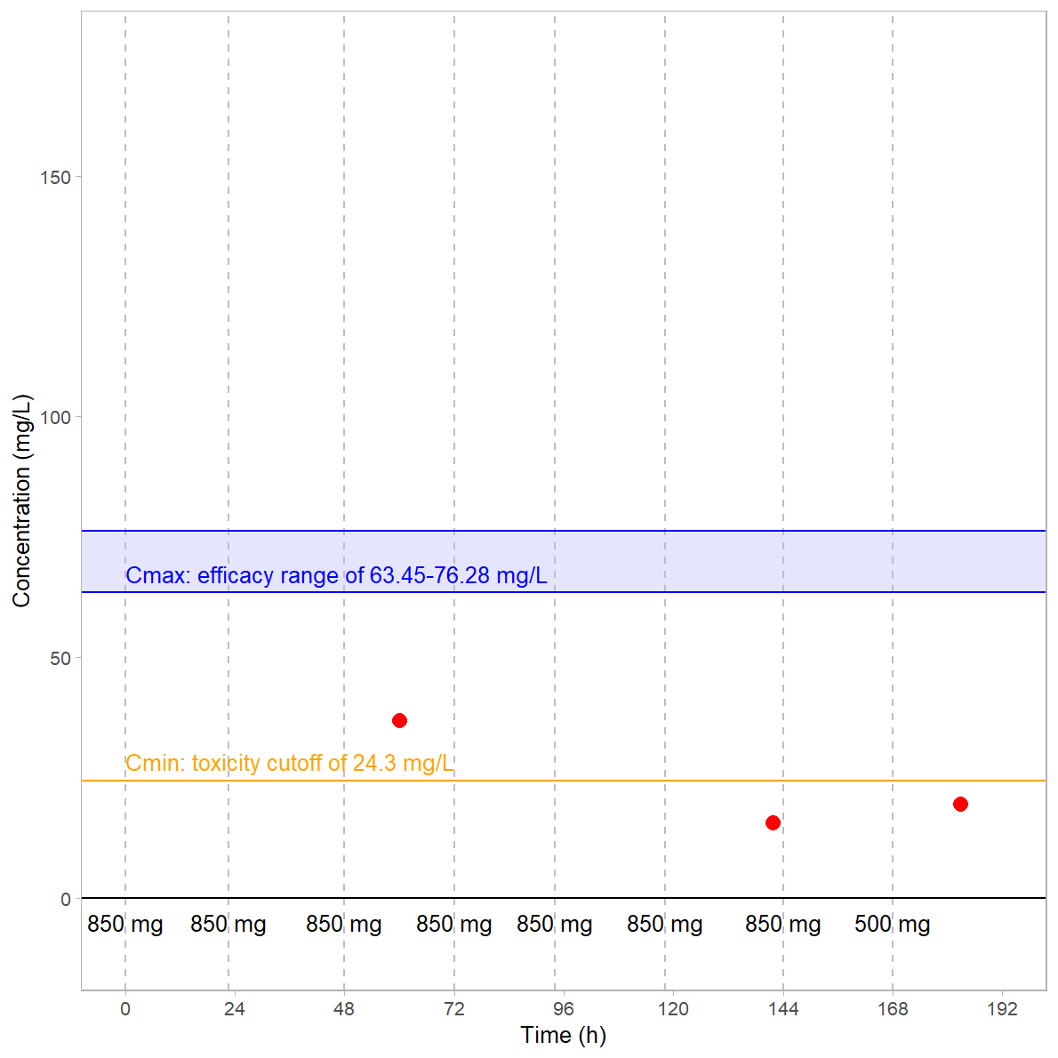
Consider patient X…
Patient X
Weight: 82.8 kg
Creatinine clearance: 78.6 mL/min
Female (SEX=1)
Daily infused doses of daptomycin 10 mg/kg (later lowered to 6 mg/kg) to treat MRSA
MRSA MIC is 1 mg/L
Three observations, at 60 h, 142 h, 183 h after the first dose
Question: what is the minimum dose needed to ensure that the AUC₂₄/minimum inhibitory concentration (MIC) at steady state exceeds 666?

Slide 41
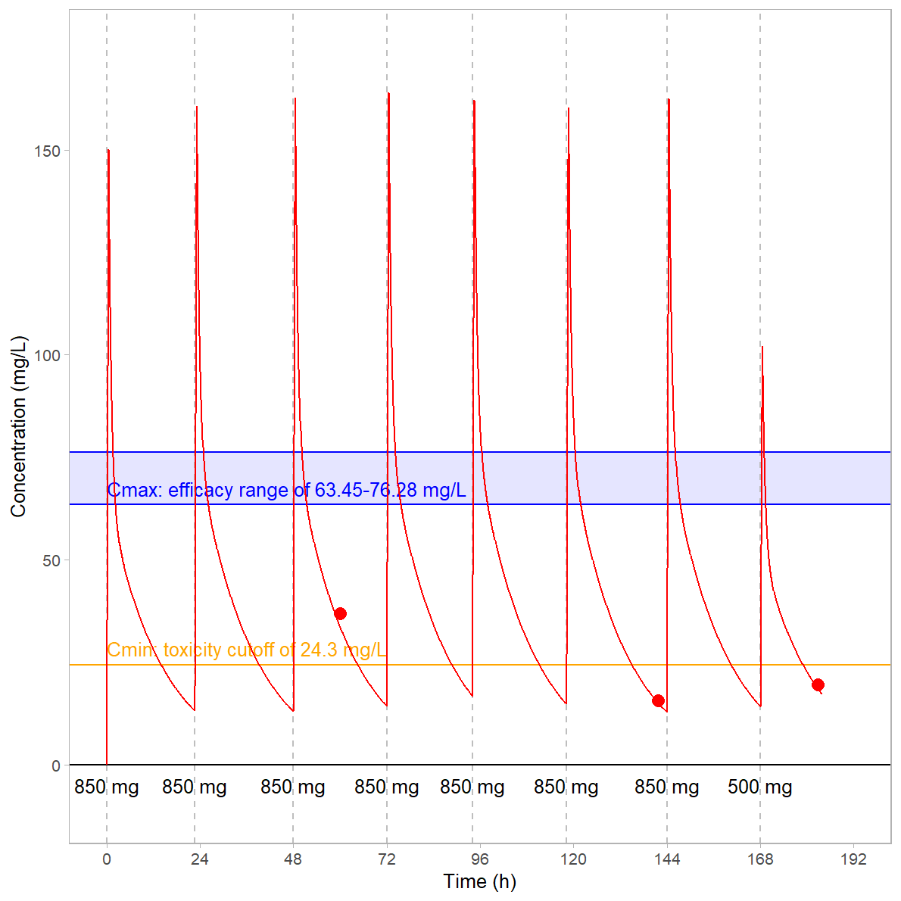
What does this patient’s concentration-time profile actually look like?
Let’s find out…
poso_estim_map() provides:
Maximum a posteriori (MAP) individual parameters for individual patients based upon their data and the model...
Predicted concentration-time curve based on their dosing history
Rolling AUC
This patient’s data
pt17fit <- poso_estim_map(dat = subset(dat, ID==17), prior_model = rx)
The rxode2 model

Slide 42
The dose seems to be OK, but…
C_{min} appears to be on target, but C_{max} might be higher than it needs to be…
AUC between the 48 h and 72 h doses is 1003.7 mg.h/L
Since MIC is 1 mg/L, AUC/MIC=1003.7, which is >> 666
So for this patient, at least, a dose of 10 mg/kg/d is OK – efficacious and not overly toxic
However, we can see from the dose reduction at 168 h that 6 mg/kg/d might be good enough…

Slide 43
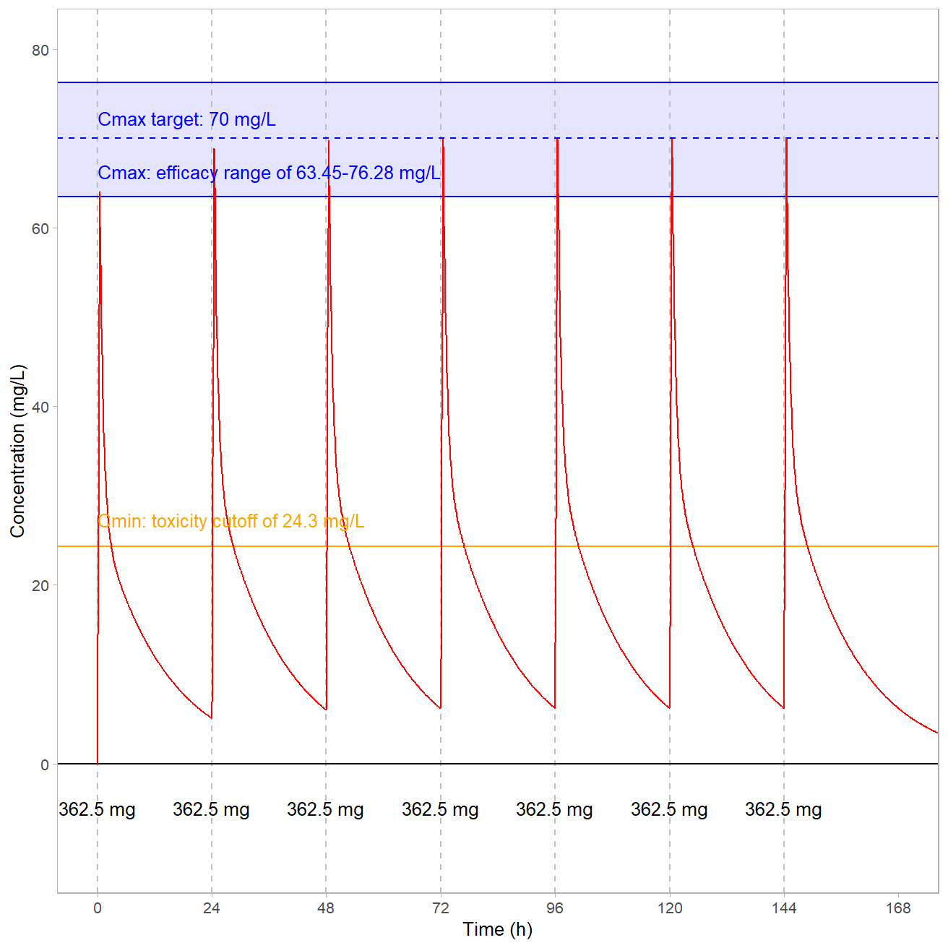
What dose do we need for C_{max} of 70x the MIC (1 mg/L)?
poso_dose_conc(dat = subset(dat, ID==17), prior_model = rx, time_c=(6*24)+0.5, time_dose=0, target_conc = 70, duration=0.5, indiv_param=pat17, add_dose=7, interdose_interval=24)
$dose
[1] 362.5345
$type_of_estimate
[1] "point estimate"
$conc_estimate
[1] 70
$indiv_param
# A tibble: 1 × 16
ID Cl_pop Q_pop V1_pop V2_pop beta_Cl_SEX_1
<dbl> <dbl> <dbl> <dbl> <dbl> <dbl>
1 17 -0.439 1.29 1.62 1.63 -0.282
# ℹ 10 more variables: beta_Cl_logtClCr <dbl>,
# beta_V2_logtWT <dbl>, a <dbl>, omega_Cl <dbl>,
# omega_Q <dbl>, omega_V1 <dbl>, omega_V2 <dbl>, SEX <dbl>,
# WT <dbl>, ClCr <dbl>

Slide 44
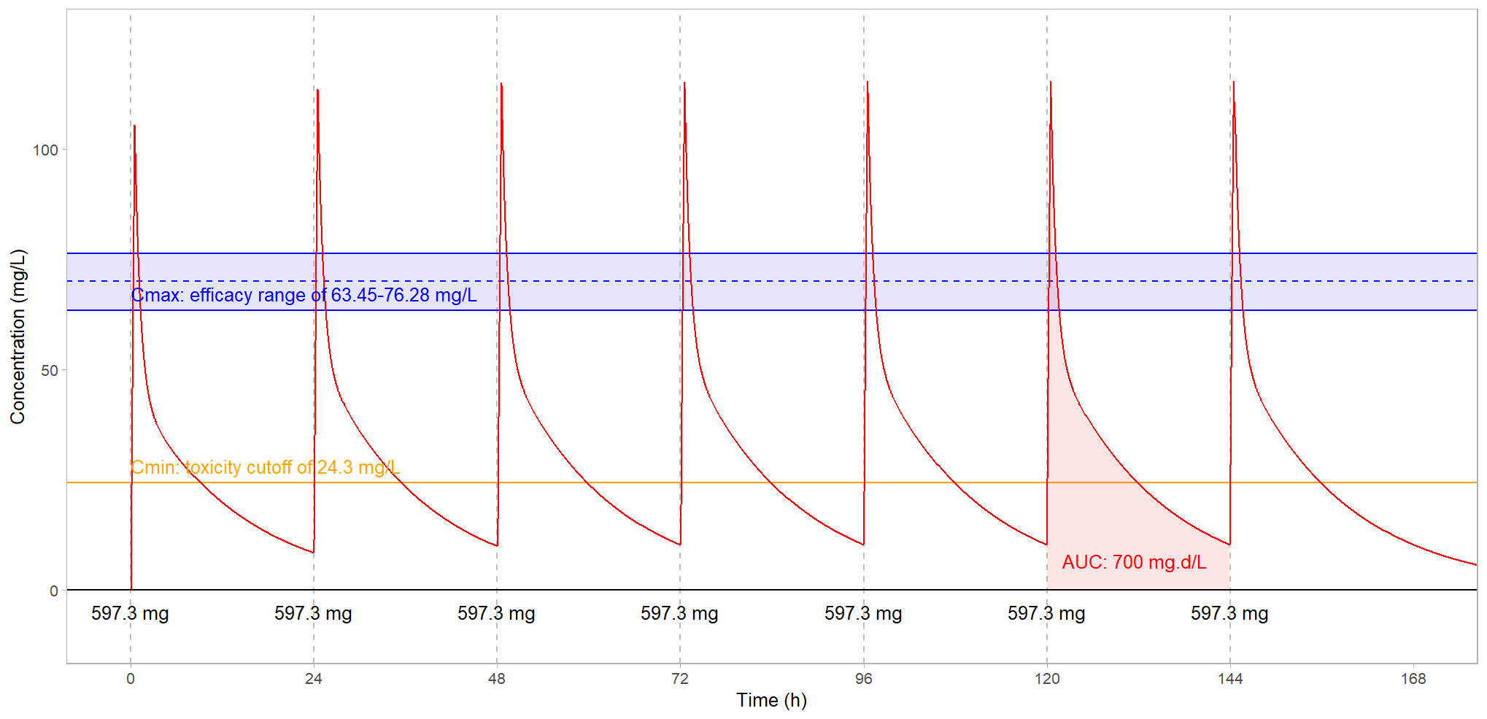
What if we wanted an AUC of 700 mg.d/L?
poso_dose_auc(dat = subset(dat, ID==17), prior_model = rx, starting_time = 144, time_auc=24, target_auc = 700, duration=0.5, indiv_param=pat17, interdose_interval = 24, add_dose = 7)
$dose
[1] 597.3235
$type_of_estimate
[1] "point estimate"
$auc_estimate
[1] 700

Slide 45
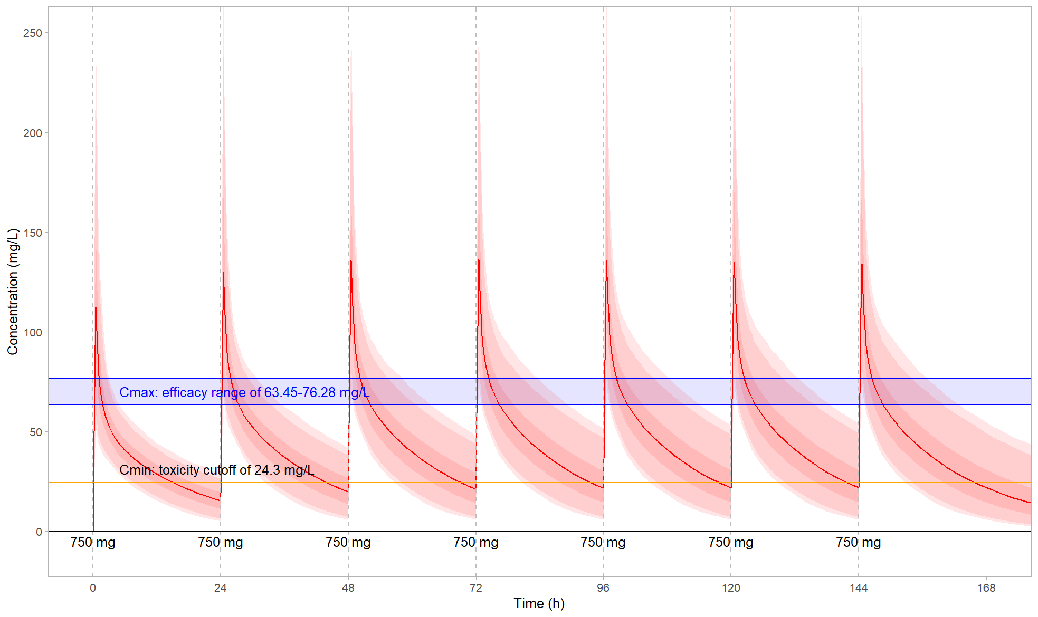
And what if we had no samples for this subject, but only their weight, CrCL and sex…?
We can simulate profiles using our patient’s covariate profile
Clearly, a dose of 750 mg has a chance of just under 50% of exceeding the C_{min} safety limit
We would probably want to start this patient on a lower dose, collect TDM samples, and then use poso_estim_map() and poso_dose_conc() and/or poso_dose_auc() to find the best possible dose
poso_simu_pop(dat=simskeleton17, prior_model=rx, n_simul=2000, return_model=T)
This drug’s PK are quite variable
Shaded areas are 50%, 90% and 95% confidence intervals

Slide 46
And there’s more!
posologyr provides several more utility functions:
poso_estim_mcmc(): Estimate the posterior distribution of individual parameters by MCMC
poso_estim_sir(): Estimate the posterior distribution of individual parameters by SIR
poso_inter_cmin(): Estimates the optimal dosing interval to consistently achieve a target Cmin, given a dose, a population pharmacokinetic model, a set of individual parameters, and a target concentration
poso_time_cmin(): Estimates the time required to reach a target trough concentration (Cmin) given a population pharmacokinetic model, a set of individual parameters, a dose, and a target Cmin
poso_replace_et(): Update a model with events from a new rxode2 event table, while accounting for and interpolating any covariates or inter-occasion variability

Slide 47
In conclusion
posologyr provides a toolkit to leverage pharmacometrics models with very limited PK/PD data in order to optimize individual dosing in a clinical setting
It’s capable of a lot more than we’ve shown you, and is in ongoing development
This presentation is based on version 1.27, currently on CRAN
posologyr is developed by Cyril Leven with contributions from Matthew Fidler, Emmanuelle Comets, Audrey Lavenu and Marc Lavielle
https://levenc.github.io/posologyr/
https://github.com/levenc/posologyr/
https://cran.r-project.org/web/packages/posologyr/index.html

